Slide 1
Shared Community Health Needs Assessment (CHNA)
Data Summary
Kennebec County Report
Fall 2015/Spring 2016
[name]
[date]
Notes:
Welcome/Introductions
Maine Shared Health Needs Assessment & Planning Process Project, also called Maine SHNAPP. The mission is to create the framework and approach for a shared CHNA that:
[a] provides valuable population health assessment data to interested organizations and individuals,
[b] supports public health accreditation efforts, and
[c] addresses community benefit reporting needs of hospitals.
Ultimately, the Maine SHNAPP seeks to turn data into action and create the healthiest population in the USA.

Slide 2





Maine SHNAPP Funders
Notes:
This project is supported financially and with resources by the four largest hospital systems in Maine and the Maine CDC.
This is the 1st state-wide public private partnership of its kind in the nation.
Brief history -- EMHS, MG, and MH worked together in 2010-11 to create the OneMaine Health Collaborative CHNA and the Maine CDC completed the 2012 SHA.
Statewide Coordinating Council for Public Health facilitated the conversation among Maine CDC/DHHS and hospital leaders to work together on a unified health needs assessment and community engagement process – resulting in the Maine SHNAPP & Shared CHNA.

Slide 3
Data included in the Reports
Notes:
Handout either Indicator List (with all 160+ items along 18 domains) & (short) Kennebec County Summary Report or handout full table of Kennebec County Indicators
Background: Maine SHNAPP has two active subcommittees – Metrics and Community Engagement – that work in respective areas of expertise and provide recommendations to the Steering Committee run by representatives in leadership roles from each of the organizations represented within the MOU
Metrics Subcommittee took almost 2 years prior to this report to vet indicators and carefully selected the ones in this report
Metrics Subcommittee and Steering Committee contracted with Market Decisions to assist with analysis of secondary quantitative (collaborated with epidemiologists from Maine CDC), complete the Stakeholders Survey, and write 17 full-length reports [1 state, 16 county] along with 24 summary reports [16 county, 5 public health district, 3 urban area]
The Kennebec County Report will form MaineGeneral’s and Inland Hospital’s CHNA along with the Central District (Kennebec & Somerset Counties) Public Health Improvement Plan – all hospital and public health improvement plans will inform the State Health Improvement Plan

Slide 4
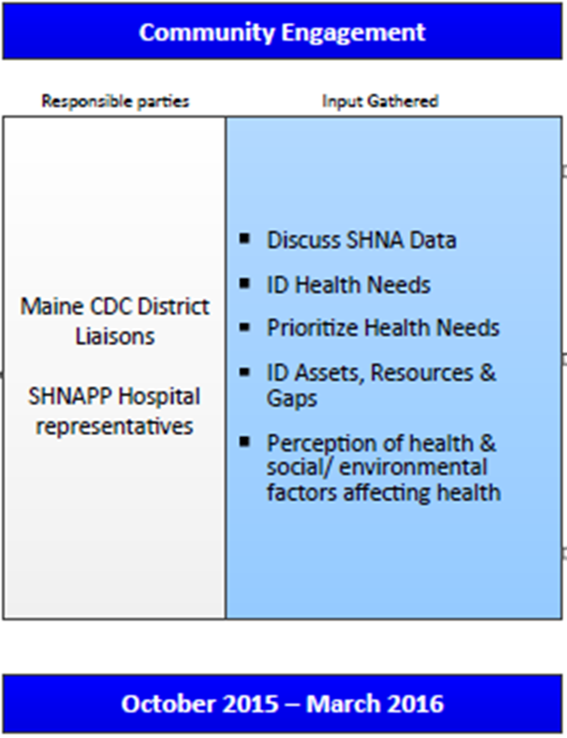
SHNAPP Process:
Notes:
Describe coordination for non-profit hospitals & public health (PH infrastructure and SHNAPP’s reliance on DLs & DCCs)
Use shared CHNAs to obtain input from diverse community members (agencies & individuals)
IRS requirements for:
-Non-profit hospitals
-Public health
-Medically underserved, low-income, & minority populations (members of groups or representatives from agencies serving groups)
Public Health Accreditation Board (PHAB) for:
-other government agencies (in addition to public health)
-not-for-profit groups
-statewide associations
-faith-based organizations
-businesses
-voluntary organizations
-academia
-military
-representatives from 2+ populations at higher risk or have poorer health outcomes
What we are doing today satisfies “community engagement” requirements & will be documented
[hospitals only] SHNAPP community engagement phase goes beyond minimum IRS requirement to obtain written comment from these groups.
CE phase supports Maine CDC in achieving and maintaining accreditation through documentation of this process and community input.
Input gets incorporated into Maine SHNAPP hospitals’ Implementation Strategies (IRS requirement) and District Public Health Improvement Plans
Community Engagement Guidance document created by SHNAPP CE Subcommittee as a resource for local SHNAPP CE Committees led by Maine CDC District Liaisons and non-profit hospital community benefit representatives. Discuss how participation on SHNAPP CE Committee helps the process (and potentially people/organizations involved)….

Slide 5
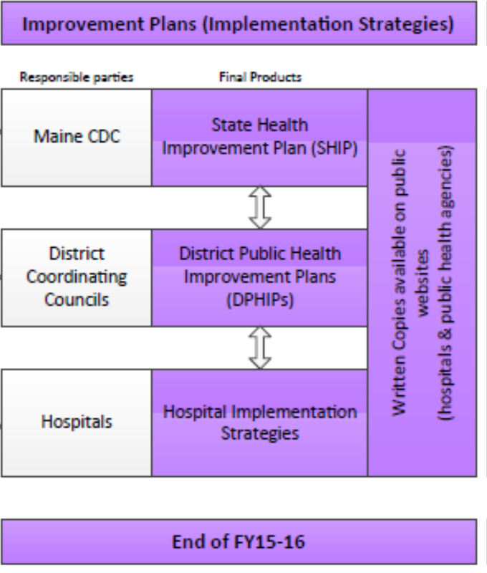
SHNAPP Process:
Notes:
Input gathered during CE Phase and shared CHNA reports will inform these plans.
Ideally, non-profit hospital community benefit representatives will work closely with Maine CDC District Liaisons and local Community Engagement Committees to co-create IS/DPHIPs.
“End of FY” varies depending on FY of each hospital – example of MG & CMHC (6/30/16), EMHS & MH (9/30/16), St. Mary’s (12/31/16). This satisfies the IRS requirement for CHNA/Implementation Strategy.

Slide 6
SHNAPP Process:
Notes:
Input gathered during CE Phase and shared CHNA reports will inform these plans.
Ideally, non-profit hospital community benefit representatives will work closely with Maine CDC District Liaisons and local Community Engagement Committees to co-create IS/DPHIPs.
“End of FY” varies depending on FY of each hospital – example of MG & CMHC (6/30/16), EMHS & MH (9/30/16), St. Mary’s (12/31/16). This satisfies the IRS requirement for CHNA/Implementation Strategy.

Slide 7




Our Task Today….
Notes:
We’ll be referring to condensed data from the Shared CHNA Kennebec County Report: Data Summary Sheets and Priority Health Issues and Factors tables to identify topics that affect the population of Kennebec County
As we consider these data within the context of the current (2013) CHNA/Implementation Strategy, some topics will command immediate attention and others will be “parked” for later attention

Slide 8
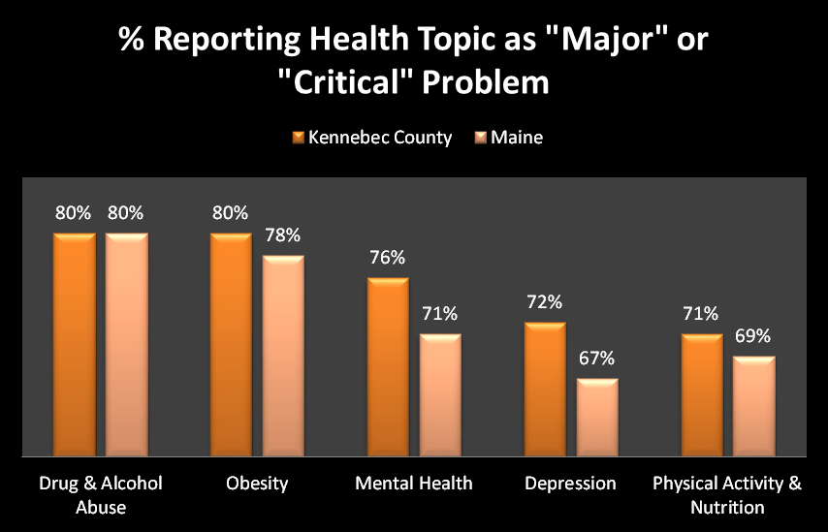
Top health issues for Kennebec County
2015 Stakeholder Survey - Total 1,639 surveys; Kennebec 220 surveys
Source: Maine SHNAPP Stakeholder Survey, 2015
Notes:
Stakeholder Survey – primary data source; instrument designed in collaboration with Maine SHNAPP Steering Committee and work groups
4 domains of questions: [1] stakeholder demographics, [2] health issues with greatest impact, [3] determinants of health, [4] health priorities and challenges
Snowball sample – stakeholder agencies received survey and shared with members/stakeholders
Total sample = 1,639; Kennebec County = 220
Respondents represented health care agencies, public health agencies, law enforcement, municipalities, schools, businesses, social service agencies, and NGOs
Ranking above came from a list of 25 health issues [family health, chronic diseases, infectious diseases, healthy behaviors, other health issues]
Respondents were asked to identify on a scale of 1 to 5 where “1 is not at all a critical problem”, “4 is a major problem”, and “5 is a critical problem”
These are the top 5 health issues for Kennebec County
The top 5 health issues for the state were:
Drug & Alcohol Abuse (80%)
Obesity (78%)
Mental Health (71%)
Physical Activity & Nutrition (69%)
Depression (67%)

Slide 9
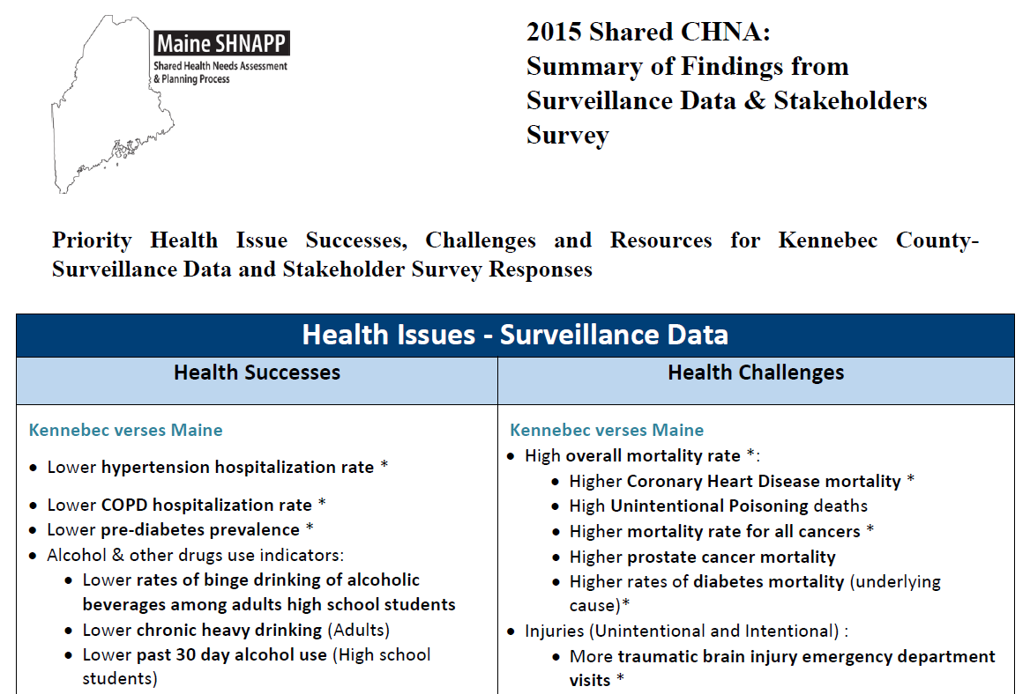
Top health issues for Kennebec County
Surveillance Data
Source: Adapted from 2015 Shared Community Health Needs Assessment, Kennebec County
Notes:
Take some time to review the handout of Health Issues – Surveillance Data to note successes & challenges
The handout also contains the Stakeholder Survey responses related to Health Issues for comparison

Slide 10
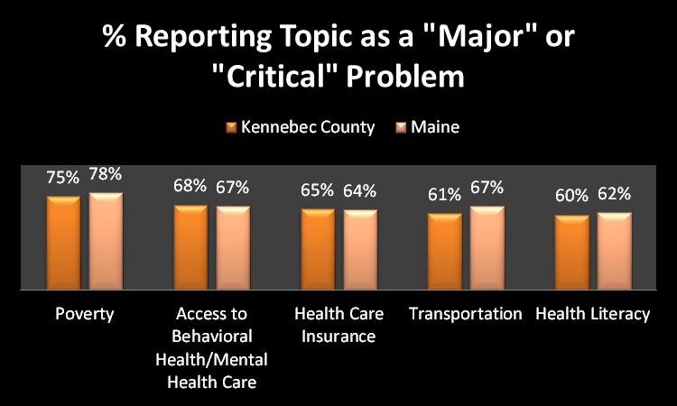
Top issues affecting where we live, work, learn & play in Kennebec County
2015 Stakeholder Survey - Total 1,639 surveys; Kennebec 220 surveys
Source: Maine SHNAPP Stakeholder Survey, 2015
Notes:
These are the top 5 issues affecting where we live, work, learn, and play in Kennebec County based on information provided by the 220 respondents from this county on the Stakeholders Survey
People who responded to the survey were asked to rank these issues on a scale of 1-5 where “1” was Not at all a problem and “5” was Critical problem. (“4” = Major problem)
The full report for the county is located at www.maine.gov/SHNAPP/
Page 24 of the Kennebec County Report shows cross tabulations of the percentage of stakeholders who agreed that significant differences exist among groups experiencing health disparities for a certain health condition [Handout?]
Page 25 of the Kennebec County Report shows cross tabulations of the percentage of stakeholders who identified certain factors/social determinants as key drivers that lead to a specific health condition [Handout?]
The top 5 health factors for the state were:
Poverty (78%)
Access to Behavioral/Mental Health Care (67%)
Transportation (67%)
Health Care Insurance (64%)
Employment (64%)

Slide 11
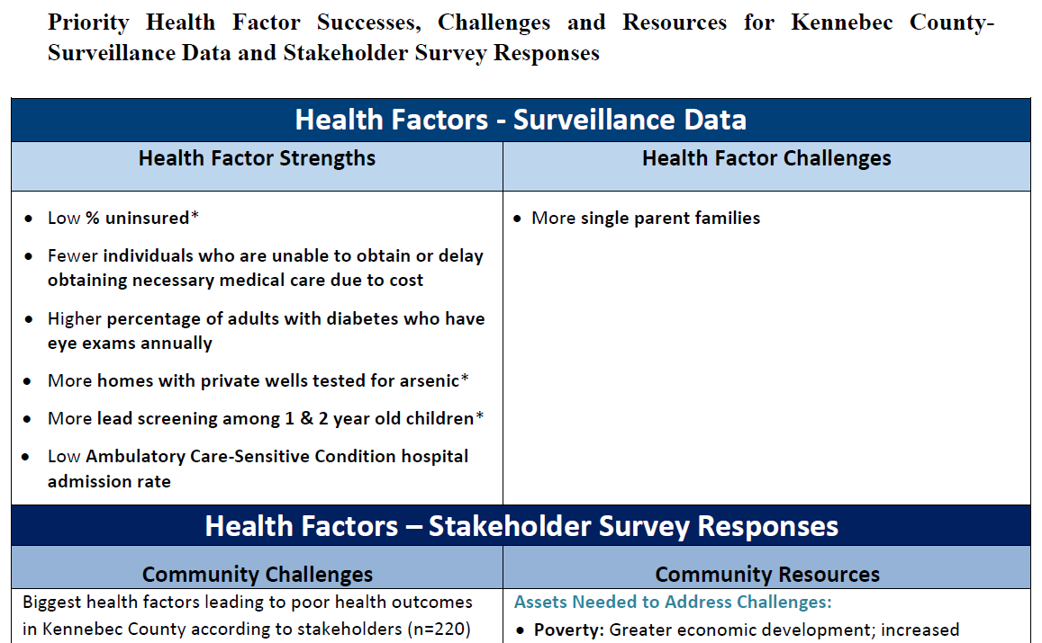
Top issues affecting where we live, work, learn & play in Kennebec County
Surveillance Data
Source: Adapted from 2015 Shared Community Health Needs Assessment, Kennebec County
Notes:
Take some time to review the handout of Health Issues – Surveillance Data to note successes & challenges
The handout also contains the Stakeholder Survey responses related to Health Issues for comparison

Slide 12
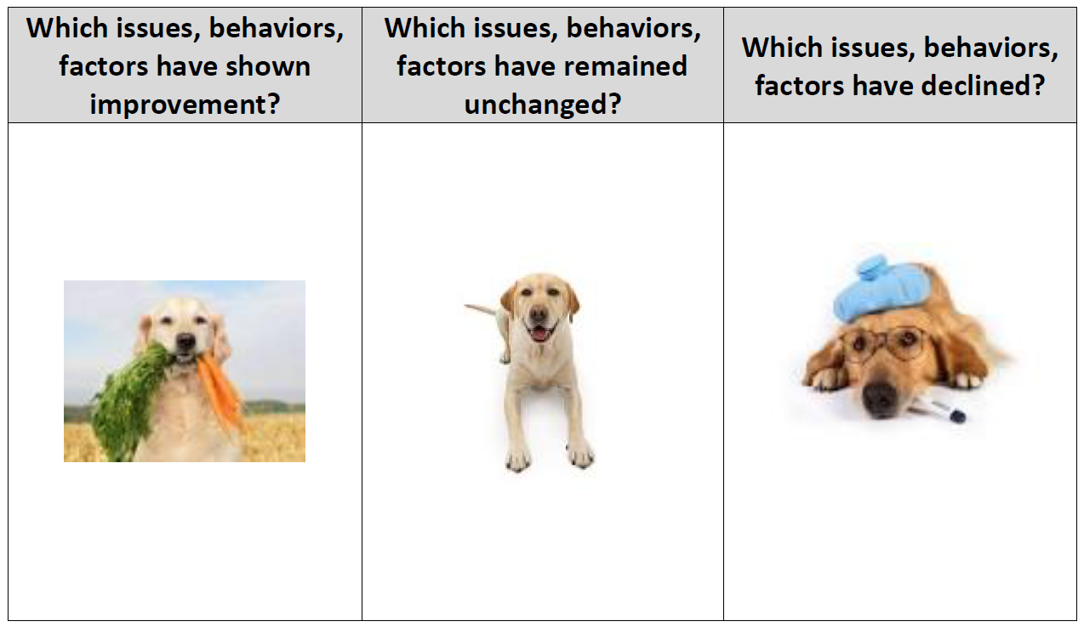
Comparing these results with our current CHNA & Implementation Strategy….
Notes:
Capture initial comments and feedback from group?
Responses can be listed as significant health issues and/or ask group members to identify priorities

Slide 13
Comparing these results with our current State Health Assessment & DPHIP….
Notes:
Capture initial comments and feedback from group?
Responses can be listed as significant health issues and/or ask group members to identify priorities

Slide 14



What are the next steps?
Notes:
Capture notes on the group’s thoughts…..

Slide 15
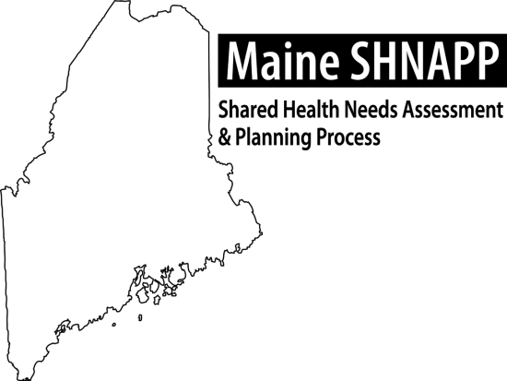
Shared CHNA Contacts
Maine CDC District Liaison SHNAPP Hospital Representative
Paula Thomson Natalie Morse
287-2613 861-5272
Paula.Thomson@maine.gov Natalie.Morse@mainegeneral.org
Additional SHNAPP Contacts Additional SHNAPP Contacts
Name Name
Phone Phone
Email Email
Shared CHNA Reports: www.maine.gov/SHNAPP/
Notes:
Add local contacts
Recommendation – print this slide as a Handout for participants

